Slide 1
Technical Presentation on the Hydrogen Powered Engine
Ben Ebel
Notes:
Hello my name is Ben Ebel and this is my technical presentation on Hydrogen Powered Engines.

Slide 2

Ben Ebel
Computer Engineering
Senior
Graduating in Fall of 2024
Notes:
First a little bit about myself, I am a computer engineering Senior expected to graduate in 2024

Slide 3
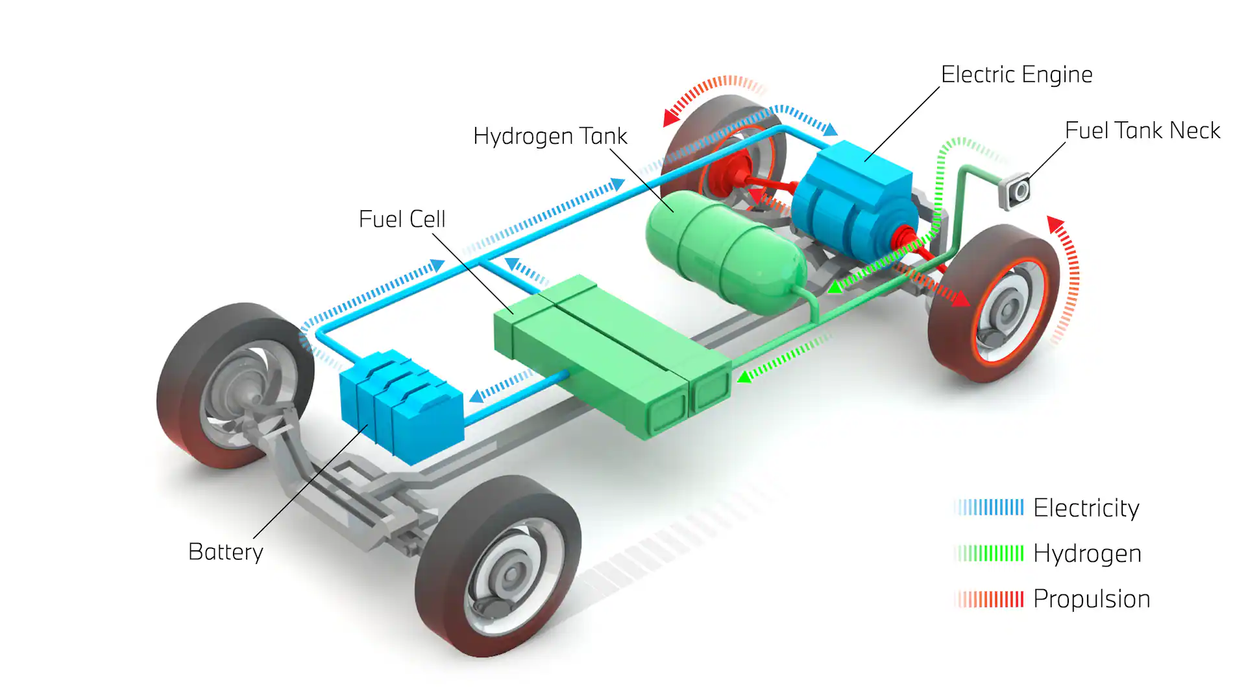
Brief History on the Hydrogen Engine
Notes:
First a Brief History on Hydrogen Engines
Currently, the 2 main fuel sources for cars in the United States are fossil fuels like gasoline and electricity but there is a lesser-known source: hydrogen.
Hydrogen was first used to power an engine in 1807 by Isaac de Rivaz and since then the concept has been touched on multiple times but it has made more of a comeback in recent years. With advancements in technology and the search for a more carbon-neutral form of transportation, the past 10 years, has seen a lot of advancements in hydrogen engines. One of these advancements being the hydrogen fuel cell vehicle or FCEV.

Slide 4
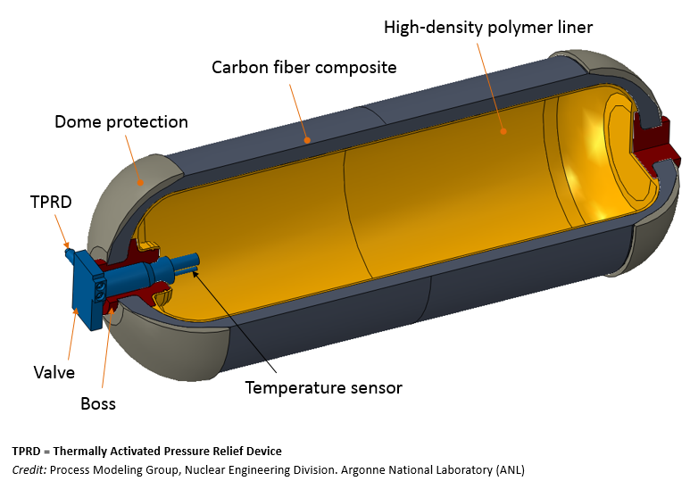
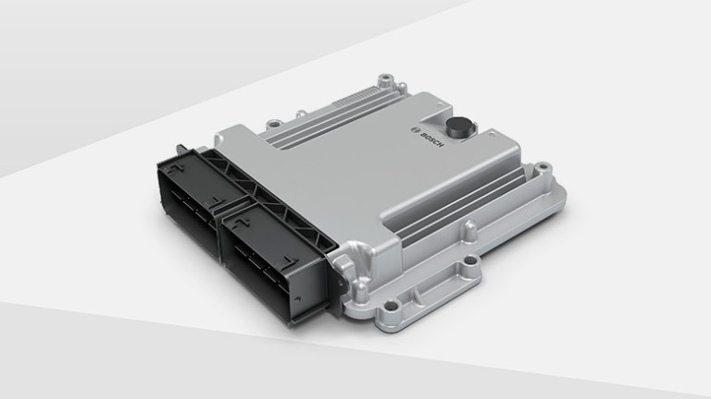
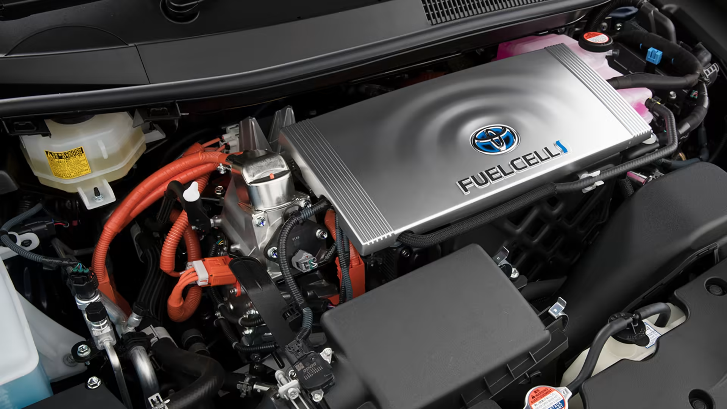
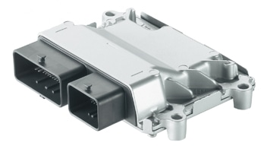
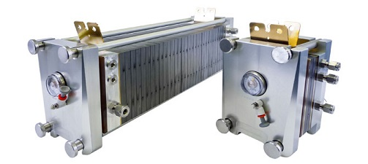
Integral Components
Fuel Tank
Fuel Cell Stack
Fuel Cell Control Unit
Electric Motor
Power Control Unit
Notes:
Hydrogen storage tank.
Similar to a battery pack or a gas tank, hydrogen-powered cars use a 700 bar Type 4 pressure vessel or vessels to store the Hydrogen gas. The vessel is made up of a carbon fiber composite with a high-density polymer liner with an interior pressure and temperature sensor to monitor the tank. This may seem very risky since hydrogen gas is very reactive but the tank is so highly pressurize that even when hit with a bullet in a car that is on fire it will dissplate faster than it can ignite.
Fuel cell stack.
A fuels cell stack is made up of hundreds of hydrogen fuel cells that generate the electricity for the electric motor. This is done by using a process called reverse electrolysis. This process turns hydrogen gas into water, I will be talking more about this later.
Fuel Cell Control Unit
The Fuel Cell Control Unit is in charge of controlling the release and monitoring of the hydrogen gas injector and electric air comrpesser for the hydrogen fuel stack.
Electric motor.
The electric motor is similar to any electric motor in your typical EV. It takes electricity from the power control unit and powers the engine to make the car move.
Power control unit.
The power control unit does what the name implies. It controls the delivery of electricity to the motor from the various sources on the car but in an FCEV this is predominantly from the Fuel Cell Stack.

Slide 5
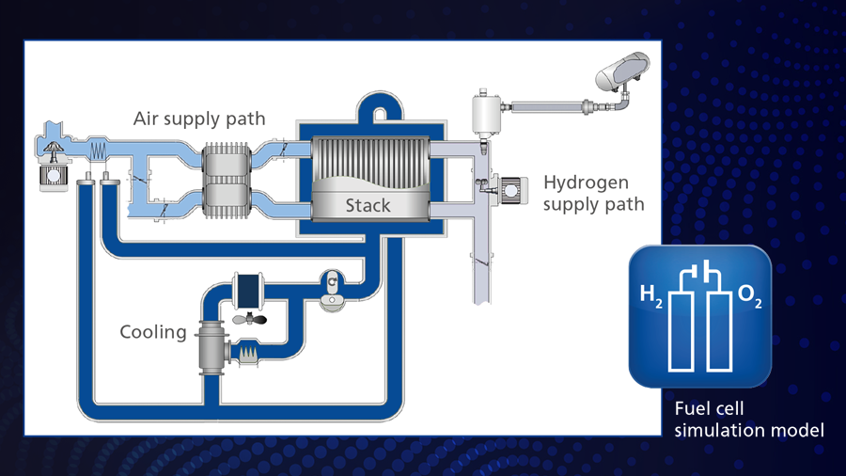
How does the system work?
Notes:
How does the system work
The systems works by using a hydrogen fuel cell stack. Oxygen and hydrogen are pumped into the fuel cell on opposing sides while the cooling system is used to ensure the stack does not overheat from the production of electricity.

Slide 6
What Does a Hydrogen Fuel Cell Do?
Notes:
What does a hydrogen fuel cell do?
A hydrogen fuel cell takes chemical energy and converts it into electricity through the proton exchange membrane. The hydrogen fuel cell is made up of 3 main parts.
The Anode, which is made of a platinum powder that breaks the hydrogen gas into a hydrogen ion and it’s electron.
The Cathode, which is often made of nickel that take the hydrogen ion that has passed through the electrolyte membrane and converts it back into water.
The Polymer Electrolyte membrane layer is composed of a proton exchange membrane made of Nafion, a brand of sulfonated tertafluoroethylene fluoropolymer-copolymer.

Slide 7
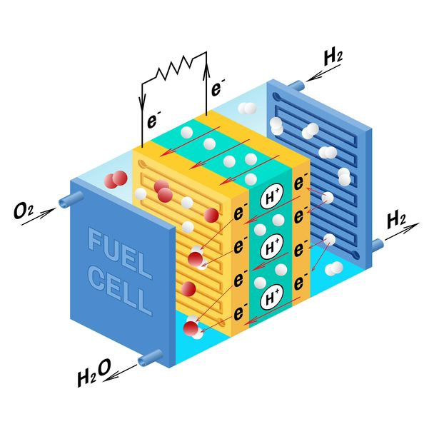
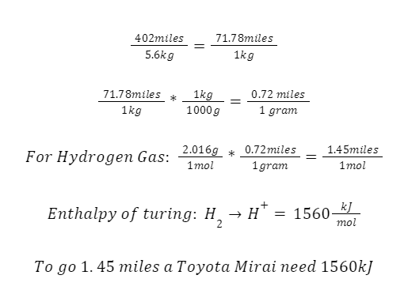
How Does the Process Work?
Notes:
How Does the Process work?
This whole system works like this. Hydrogen gas is let in to the anode side. The platinum in the anode then oxadises the hydrogen gas turning it into positively charged hydrogen ions and electrons. The polymer then allows the hydrogen ion to transfer across leaving behind the hydrogen electron. The electron then follows an external circuit creating a DC current from the electrons flowing. This power is then taken to the inverter which converts it to AC power for the electric motor. This process normally creates heat and is the reason that the fuel cell stack needs a coolant system. After the Hydrogen ion has passed through the polymer, oxygen is is pumped into the cathode which then bonds with the hydrogen ion and creates a water molecule. This is then exhausted through the tail pipe of the vehicle in the form of steam. Sometimes there is left over water in these cells so most FCEVs have a dedicated H2O dump button.
One singular fuel cell cannot do this alone this is why inside a hydrogen vehicle there are hundreds of fuel cells to power the vehicle because and electric motor moving a vehicle at this weight needs a lot of power.
Some hydrogen vehicles even have a battery to store excess energy made in this process and the regenerative energy processes inside the vehicle such as regenerative braking.
(Press keyboard) Lets do some math. A Toyota Mirai can go 402 miles on 5.6kg of Hydrogen gas which is the tank size of the toyota mirai. This means that it can go around 71.78 miles per kilogram of Hydrogen gas. Doing another conversion we can see that this is equivalent to 0.72 miles per gram of hydrogen gas. Now a mole of hydrogen gas is equivalent to 2.016 grams so using the previous equation we can multiply this by 0.72 miles per gram and get that 1 mol of hydrogen gas in the toyota mirai can go 1.45 miles. Using the enthalpy calculation of turing hydrogen gas into a hydrogen ion is roughly 1530 kJ/mol. This means that for every 1.45 miles around 1530kJ is needed. All this power was created without any harmful carbon emissions.

Slide 8

Benefits
Notes:
Benefits
The benefits with a system like this is that the car itself is a completely carbon neutral vehicle. The entire chemical process inside the car takes in Hydrogen Gas and Oxygen and produces water that maybe one day you could drink.
Another benefit to this over traditional EVs is it takes roughly the same amount of time to fill up your car with hydrogen as it does gasoline and gets the same mileage or more.

Slide 9
Down Sides
59 Pump Stations in the US
$16 per Kilogram
Not really “Carbon Neutral”
Notes:
Downsides
You might be thinking this seems like an amazing idea why don’t I just go by an FCEV right now. There are currently only 59 Hydrogen Pumps in the United States, most of which are in California. Additionally the price of an FCEV is very expensive right now because of the high quality materials needed to ensure the safety of the users inside the vehicle. Lastly, the high cost of transporting hydrogen gas to the hydrogen stations makes the price per kilogram of hydrogen 16 dollars.
Also the vehicle itself may be carbon neutral but the process of getting the gas and transporting it right now are not. Currently the main way to get hydrogen gas is through steam methan reforming electrolysis which requires fossil fuels. This process could be done with renewable energy sources but currently there just isn’t enough demand or support for this idea to work.

Slide 10
In conclusion
Notes:
In Conclusion
Hopefully now you should have a very indepth understanding of how the Hydrogen Fuel Stack inside the Toyota Mirai allows the vehicle to run and a better understanding of the benefit of a hydrogen powered car. Sadly this is not the msot poular

